Slide 1
Python
group : Ted ,King ,Zero ,
Leo ,Jax ,Lester

Slide 2
This is a simple procedure for bank management,The main functions are:
1. menu,
2. put money in,
3. get money in,
4. show account with most money,
5. show account with most transaction,
6. show one account,
7. show all account,
8. show total number of transaction,
9. exit

Slide 3
In the future, I think the room for improvement of our program lies in the ability to design several web pages to make its appearance more beautiful, to add their photos to every customer, and to connect or set passwords
在未来，我认为我们的程序的提升空间，在于可以设计几个网页让他的外观更加的美观，可以给每一个客户增加他们的照片，还可以连接或者设置密码等

Slide 4
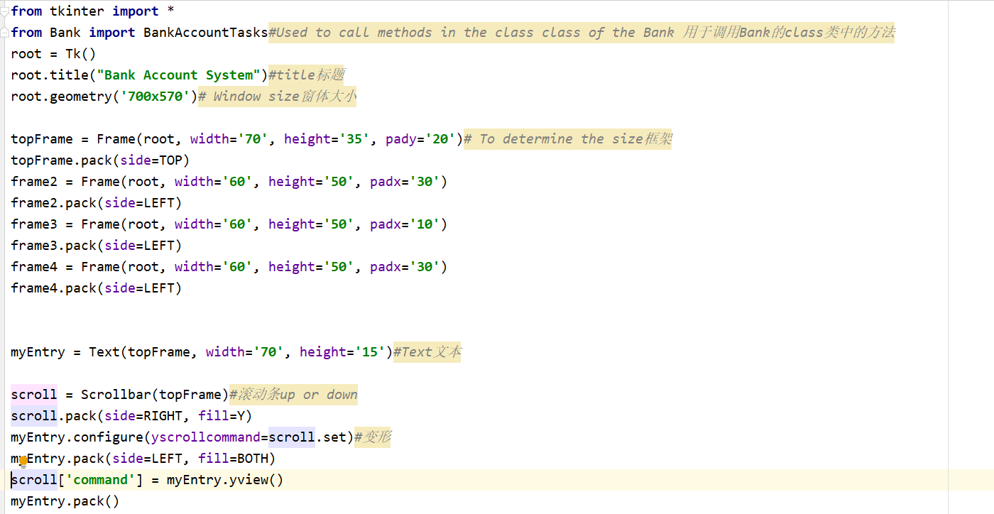
1.The worker is Jax

Slide 5
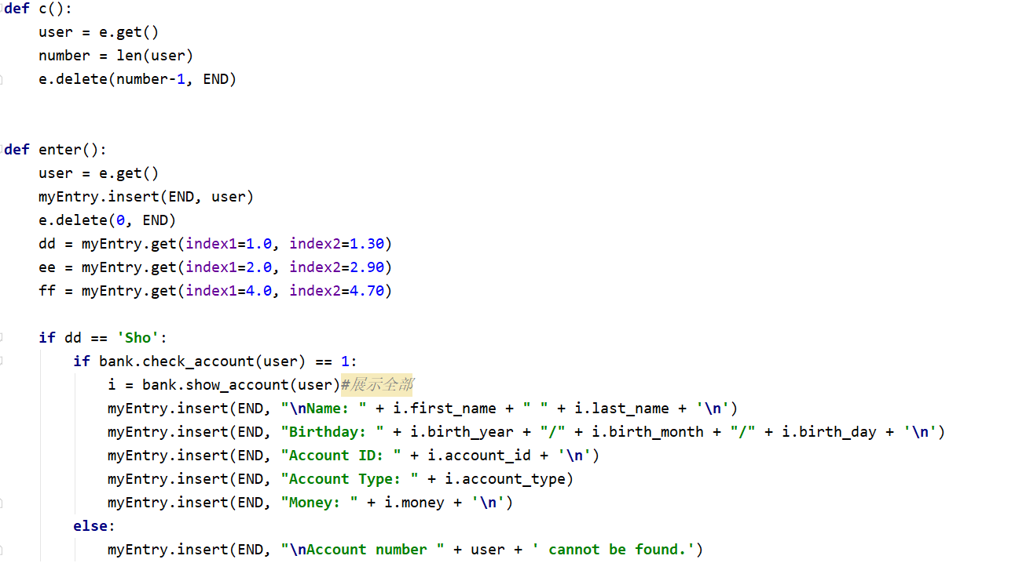

Slide 6
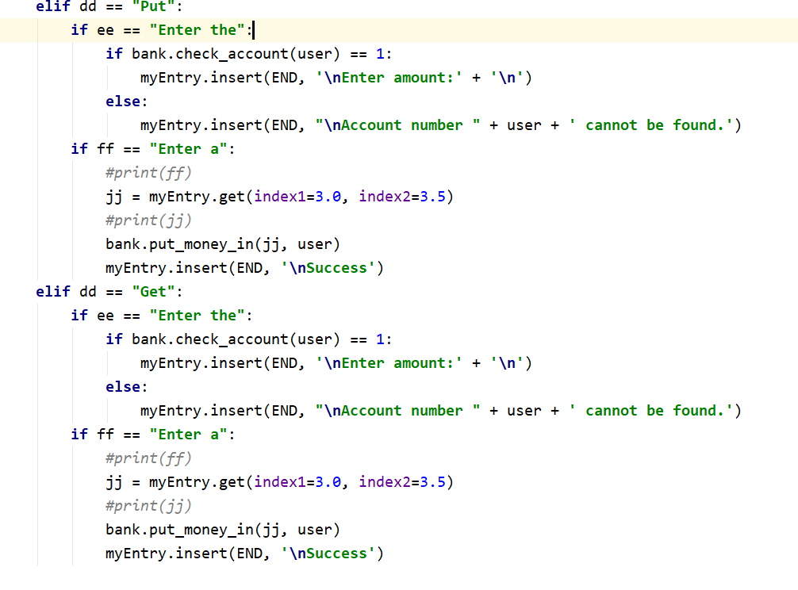

Slide 7
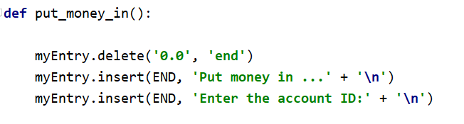
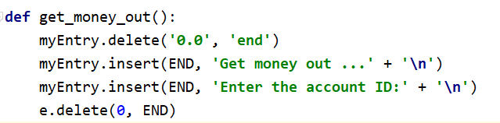
2.The worker is King

Slide 8
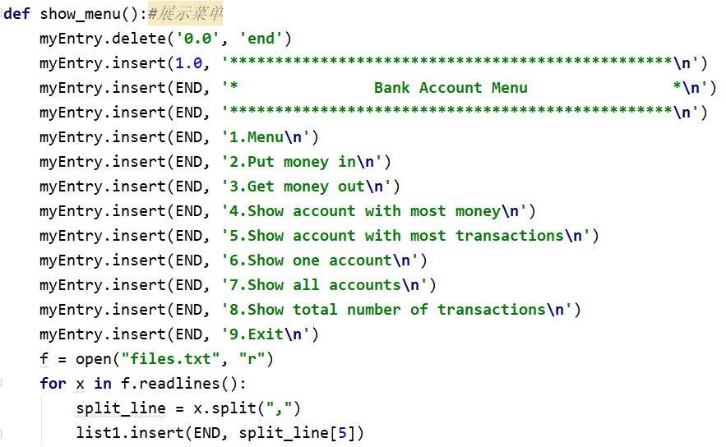

Slide 9
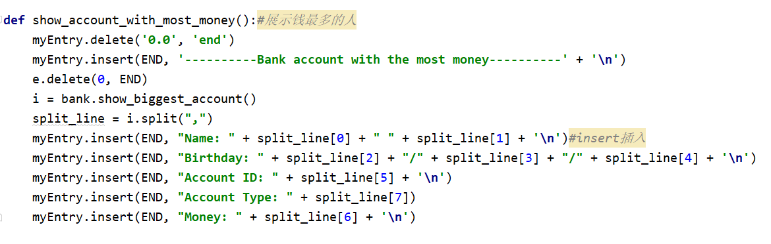

Slide 10
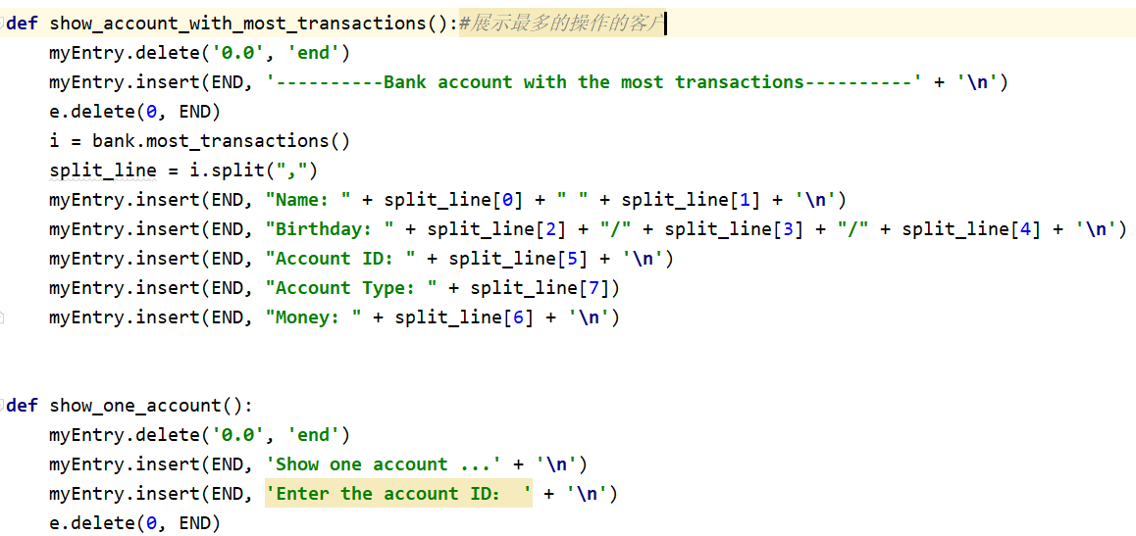
3.The worker is Leo

Slide 11
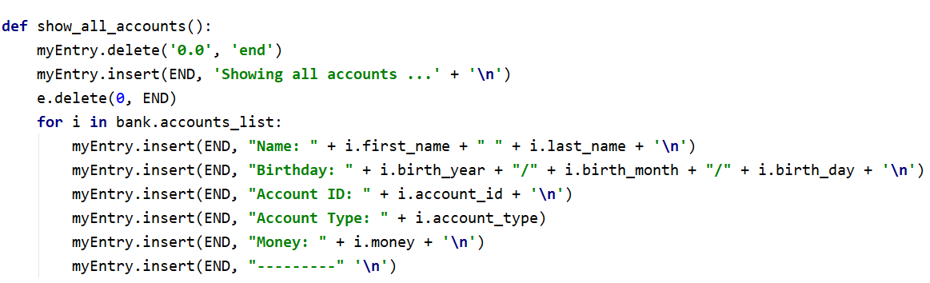

Slide 12
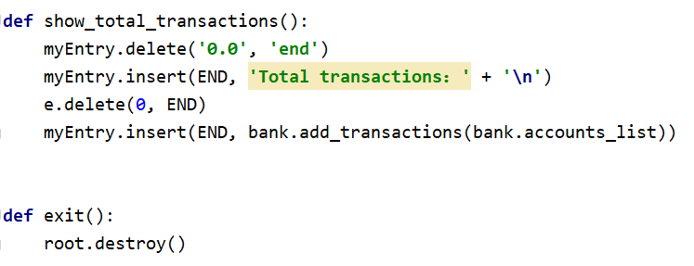

Slide 13
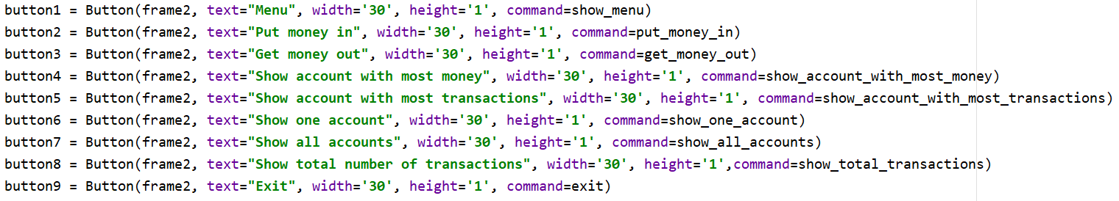
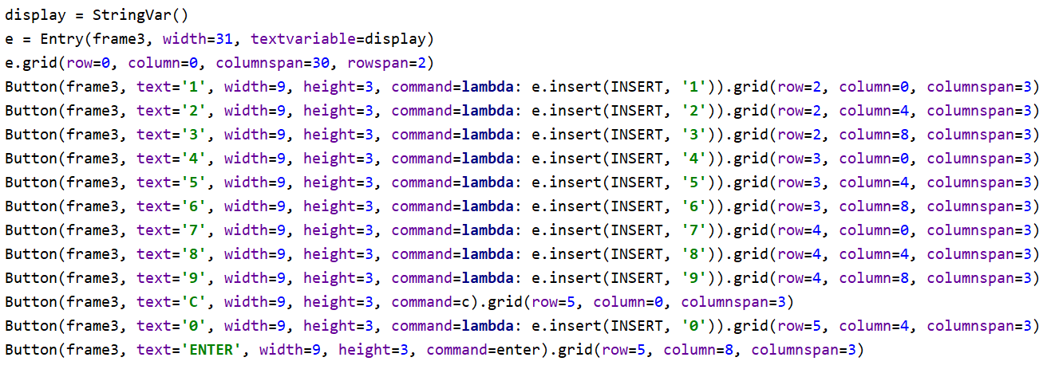
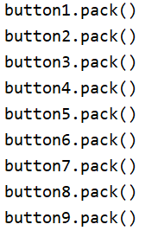
4.The worker is Zero

Slide 14
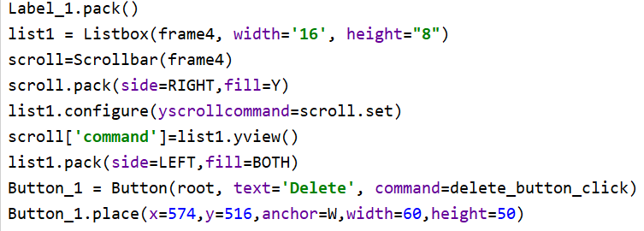
Listbox: Refers to a list box that records the specific user name and ID
指列表盒子，记录具体的用户名ID
Place：位置，x横坐标，y纵坐标
Command : use delete_button_click触发命令

Slide 15
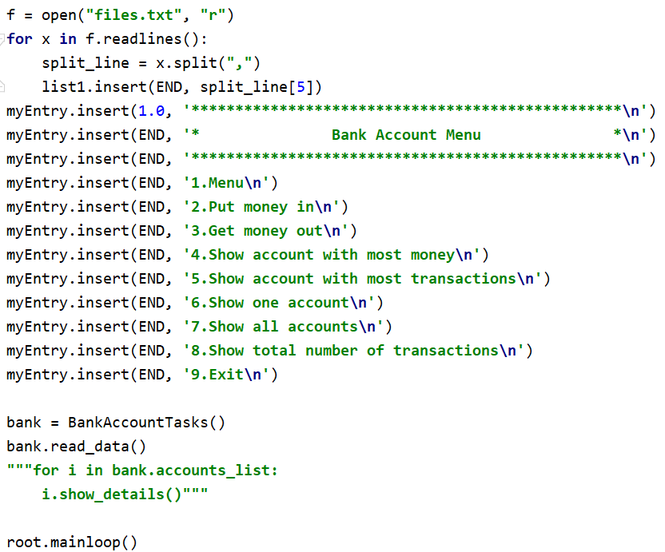
5.The worker is lester

Slide 16
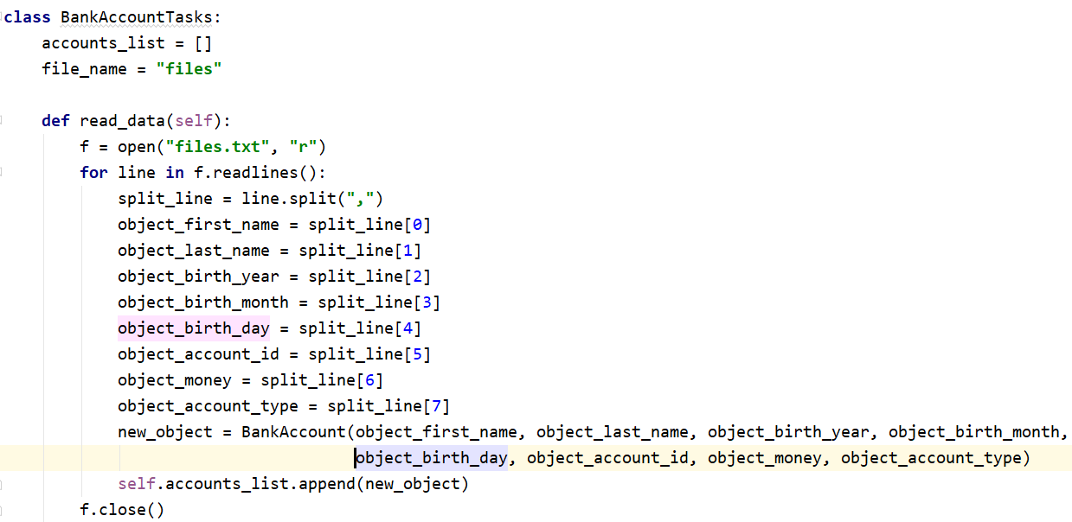
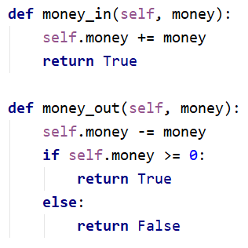

Slide 17
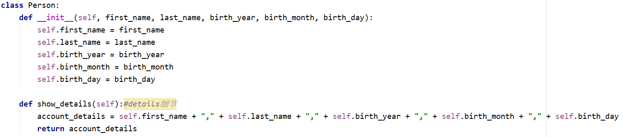

Slide 18
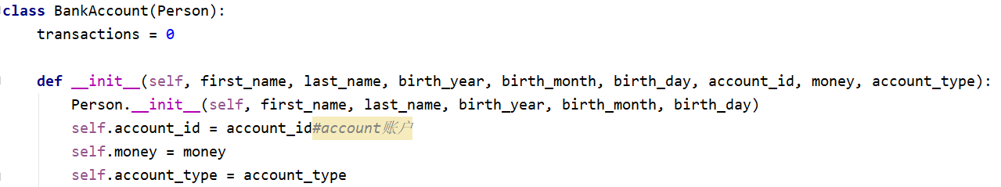
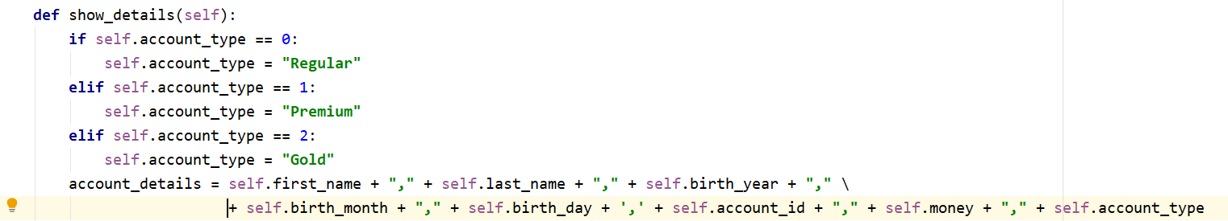
6.The worker is Ted
展示细节

Slide 19
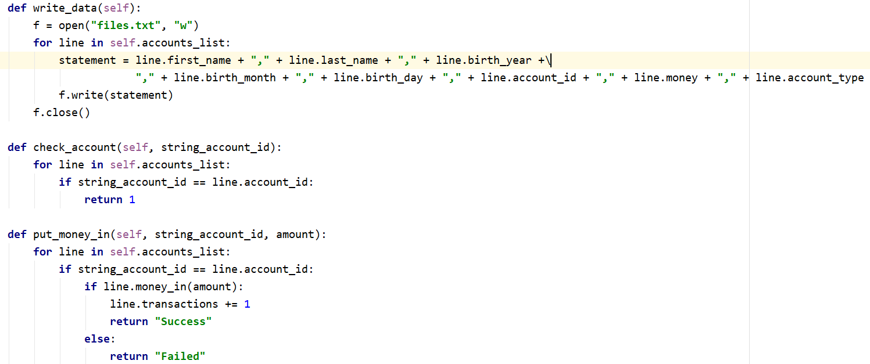

Slide 20
